Slide 1
DIRECT Professional Development Seminar: Project and Team Management

Slide 2
Topics
Goals
Levels of project management and what we are talking about today
Basic principles in project management you can apply to your capstone
The art of extracting work from others and managing up
Three easy ways to mess up a project
Managing different working styles with your teammates
Additional Q&A and feedback/survey

Slide 3
Goals
Learn about different organizational styles and approaches to project management that will be useful for the capstone project
Learn about strategies for productively resolving conflict that will be useful for the capstone project?
Learn about "managing up" that will be useful for the capstone project?

Slide 4
Plan / format for today
Please participate
There will also be plenty of time at the end for Q&A

Slide 5
Types of project management
PM means a huge spectrum of different things
Career path in professional project management
Applies to lots of different industries, some jobs require specific technical skills [Technical Program Management is an entirely different type of job]
Managing a complex project at work with deliverables that involves many stakeholders
Often can take a > 6 months, regular meetings, consequences for failure
Projects with clear deliverables, some consequences and small teams
Managing your own degree milestones, a big project at your house, etc.

Slide 6
Common elements of all types of PM
A clear goal or set of objectives
Deadline or set of milestones
Established lines of reporting or authority
Defined set of stakeholders, for example:
Team members (doing the work)
Partners (giving input about the work, but not responsible)
Managers (providing resources and evaluation)
Lots of names are used, focus on function (what they do) vs form (what they are called)
Reward (if you are successful) / Punishment (if unsuccessful)

Slide 7
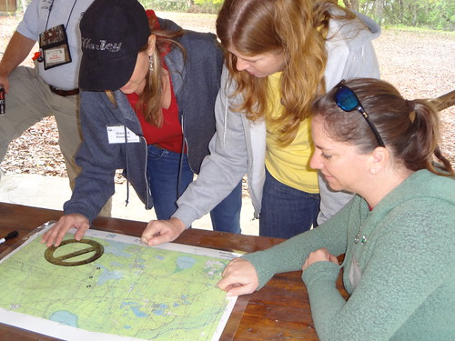

Project management is project planning
Would you describe yourself as “organized” ?
An essential capacity in the management of a complex project is the ability to plan a complex project
When cooking, I spend a lot of time getting all the ingredients ready to execute my dish
This is called ”mise en place” → French for ‘putting in place’
It takes way more time at the beginning, but finishing the product is more fun and better quality

Slide 8
“Mise en place” for your project
When you are cooking, you usually know what you want to make
The recipe tells you what you need, when you need it, and what to do with it
To successfully execute your project, you need your own recipe and you need to know the ingredients
The ability to imagine a final project and work backwards is one of the most important skills in project planning and management
Scheduling for projects is frequently done with a Gantt chart

Slide 9
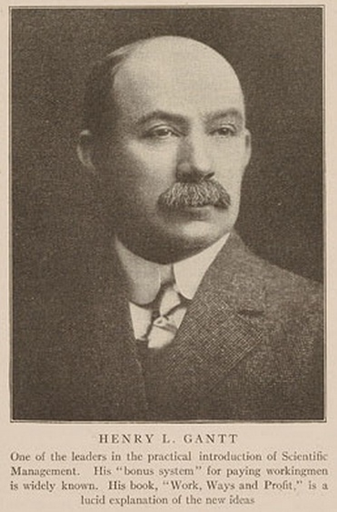
Gantt chart concept
Henry L. Gantt:
Inventor of project scheduling approach
Owner of incredible mustache
Main innovation in the Gantt chart:
Interconnected tasks on y-axis
Time on x-axis
This seems very obvious now, but was not widely used at the time
Early uses were in construction projects and manufacturing

Slide 10
My first Gannt chart
My approach is to start with your end goal and work backwards
There are different approaches, we will discuss at the end
In the beginning it is better to be more detailed – you can always combine tasks
I have observed students tend to over-focus on “what is next” without understanding the big picture
Next – identify when your project is due and subtract some time so that you plan to finish early
Students never leave margins

Slide 11
My first Gantt chart
Start at the end and work backwards with your tasks
Margin/ Contingency
Tasks
Final report and presentation
Time
Project
Due
Planned
Completion

Slide 12
My first Gantt chart
Start at the end and work backwards with your tasks
You may already have a desired project period in mind (start date must be > today ☺ )
Project Period
Margin/ Contingency
Tasks
Task 3
Task 4
Final report and presentation
Project Start
Time
Project
Due
Planned
Completion

Slide 13
My first Gantt chart
Make connections that identify required inputs/outputs
After your first estimate compare the total time estimate to estimated available time
Project Period
Margin/ Contingency
Tasks
Task 1
Task 2
Task 3
Task 4
Final report and presentation
Project Start
Time
Project
Due
Planned
Completion

Slide 14
My first Gantt chart
Make connections that identify required inputs/outputs
After your first estimate compare the total time estimate to estimated available time
INITIAL Project Period
Margin/ Contingency
Tasks
Task 1
Task 2
Task 3
Task 4
Final report and presentation
Project Start
Time
Project
Due
Planned
Completion

Slide 15
My first Gantt chart
Addressing time crunches in your planning
Decrease task lengths, start earlier, finish later, decrease margin
Be disciplined: do not spare on margin
INITIAL Project Period
Margin/ Contingency
Tasks
Task 1
Task 2
Task 3
Task 4
Final report and presentation
Project Start
Time
Project
Due
Planned
Completion

Slide 16
My first Gantt chart
What are the consequences of finishing late?
If I finish a grant 1 day late, I can’t submit it again for another year
If I finish a publication 1 day late, there may be no consequences
If you turn in your capstone late, you could fail CHEM E 547
INITIAL Project Period
Margin/ Contingency
Tasks
Task 1
Task 2
Task 3
Task 4
Final report and presentation
Project Start
Time
Project
Due
Planned
Completion

Slide 17
Using your Gantt chart
The value of your project plan is not just estimating the correct start date to meet your deadline
Check in regularly
If/when you fall behind (or get ahead), you need to make adjustments
You should keep track of the adjustments you are making and reflect on your planning skills: this is the only way to improve your capacity to accurately plan

Slide 18
Technique vs. style
There is no one way to make a Gantt chart and the name more accurately refers to the project planning style
To me, it makes most sense to start at the end and work backwards... But I mostly deal with fixed deadlines.
Technique: reliable project planning to deliver your project materials on time
Style: my project plan is a series of boxes in PPT vs Excel and I prefer to plan thinking forward vs. in reverse
Style: my project plan is written on a napkin or to do list vs. I use Asana to create professional looking Gantt charts
Do not let your preferences about style cloud your ability to develop and execute technique

Slide 19
Applying it to your capstone project
You don’t get to choose your start or end date
This is a great opportunity to practice developing project planning and management skills
You might be more interested in this than your teammates and that is OK
Work with your project mentors and 547 professors to establish a reasonable project plan for your capstone and build on your 545/6 class project experience to identify the key deliverables and space them out
You will be presenting your projects to at the end so you should feel a bit of ‘good’ social pressure

Slide 20
“Extracting work” from others
Some tasks you have to do, many tasks others can do
Delegating work to others, and learning not to micromanage, is the best way to increase your overall capacity for work
Requirements: actual authority to assign work (management) or social capital / capacity to convince others to accept the work (teammate, informal leadership)
Rewards: other people are helping you achieve your goals, you are spending time on tasks more aligned with your skill set
Risks: others do not deliver, your neuroses lead to micromanagement or wasted time
Effective delegation cannot be done unless you believe you will accept the work that is returned to you!
This often requires skill at ‘self management’ in order to be content with the different pieces you receive from your teammates

Slide 21
“Managing up”
People mean many different things by this
Sometimes we have to deliver information to our bosses at the right moment to help them be successful…
Sometimes we have to help the boss understand circumstances on the ground:
What is preventing you from accomplishing your goals?
What are timely/unique opportunities that make us adjust the goals?
In general I adopt the viewpoint that if my boss is successful, I am successful
Difficult bosses can also be managed, but complexities abound

Slide 22
Three ways to easily screw up your project
My top list of things you can do to ensure trouble
Fail to deliver on time: Students struggle most with meeting deadlines (in my experience). Learn now how to set deadlines and meet them – I cannot overstate how important this.
Have an interpersonal problem that requires management attention: Failure to manage conflict in a productive way becomes exponentially more problematic when it rises up a level
Deliver the wrong product: For example: if you are working on a prototype and you use the resources to create a final product, don’t be surprised if there are consequences

Slide 23
Conflict management and being a good partner
Who has ever worked on a team project where you felt any of the following: (raise your hand in Zoom)
Work was not distributed equally
Credit was not distributed equally
One or more team members failed to meet expectations about communication
Based on how many hands are raised right now, what is our expectation about what could happen this quarter?
Let’s explore a few ideas to promote effective work and, if needed, intervene if there is trouble brewing

Slide 24
Communication is everything
You must have a common basis of fact
After team meetings when you agree on deadlines and deliverables. Who is responsible for emailing these out to the team?
Compare if you are disputing “what was said” on a Zoom call vs. what is written in an email that all team members agreed to
Your team should mutually share top 1-2 ‘pet peeves’ and ‘likes’
What are things based on your past experience that drive you crazy and you want to avoid in this capstone? (Gives people a chance to avoid)
What helps motivate you, encourage you, etc. (Gives people a chance to help)
The stakes are low right now since nobody is doing these things
If you see that one of your behaviors might interfere with someone’s productivity, why not address it proactively? (I noticed you said X, there is a chance I might do that this Q, it is not intentional and please reach out if it happens)

Slide 25
Communication is everything
3. What is your plan to regularly check in and ask how things are going?
4. What is your plan if problems arise?
Final thoughts:
Do your best to help your teammates be successful
Be humble, helpful and have fun
Don’t be surprised if there are some bumps in the road. We all have them – it is normal. You are here in grad school training for your future careers – it would be weird if everything went perfectly.

Slide 26
Summary
Project management is project planning
Although it is possible, it is difficult to be too organized
Delegation only works if you can avoid micromanaging
Learning to be a clear and direct communication is the best capacity you can build to avoid and address conflict
Q&A?

